Slide 1
Towards the Design of Higher Capacity Peroxisomes in Saccharomyces cerevisiae
Jordan Baker
Center for Cellular Construction
Dueber Lab, UC Berkeley
Quarterly Meeting
December 3, 2021
Notes:
2nd year graduate student in the CCC
Talk about other people and similarities between their work – Ashwini, Greyson, and Angeline

Slide 2
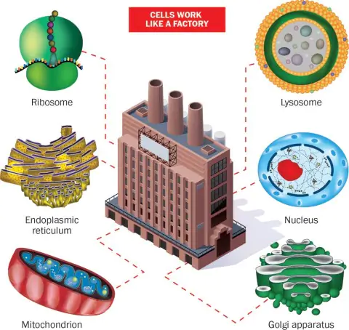
The Living Bioreactor
Washington Post. May 26, 2017. “Ever wondered how your cells work? They’re like tiny factories.”
Notes:
-You all have probably heard a lot about our themes so far, but I wanted to highlight the living bioreactor theme, which this work will focus on.
-cell as a living chemical factory where we put different substrates/chemicals in and then transform them into other useful chemicals
- take advantage of the complex and diverse set of chemical reactions natively in the cell
-improve the production of useful chemicals by re-engineering the physical structure of the cell
-Two research areas straight from the CCC website are to engineering organelle structure/size/shape/number and engineering organelles to make a specific molecule/product.
-This talk/project couldn’t fit these two research areas more perfectly

Slide 3
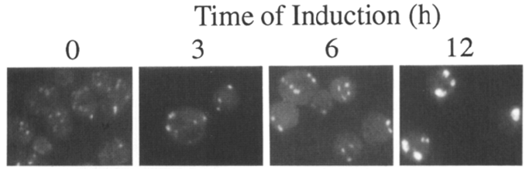
Peroxisomes as an Inducible Compartment
Peroxisomes not required in S. cerevisiae when grown on glucose
  Efficient protein localization
  Semi-permeable
Peroxisome localization can protect cells from toxic proteins and molecules
Media induction of peroxisome proliferation across organisms
  Slow growth on long chain fatty acids (oleate)
Goal – mimic proliferation independent of media
Erdmann & Blobel, 1995
Notes:
The organelle I will be talking today are peroxisomes - As Dr. Dueber previously mentioned in his talk
lot of options to control the peroxisome and its environment to perform some cool chemistries and reactions.
benefit that it’s not essential on glucose media since it’s natively used for the beta oxidation of fatty acids,
hijack the entire organelle when using glucose as the carbon source.
We can efficiently localize proteins to the peroxisome and is semi-permeable, which we use to our advantage.
We’ve also shown localizing toxic proteins to the peroxisome alleviates some of that toxicity, which I’ll touch upon at the end of my talk.
All of these are reasons why we are interested in engineering peroxisomes
As I mentioned, peroxisomes in S. cerevisiae are used for the beta oxidation of fatty acids, so When cells are fed long chain fatty acids, like oleic acid, peroxisome proliferation is induced and the size of the peroxisomes increases. This media induction is consistent across organisms with different carbon sources inducing peroxisome proliferation in different organisms, like a yeast O. polymorpha which induces large peroxisomes in methanol.
These are interesting behaviors but in terms of making a cell factory, we would want this platform to be as broadly applicable as possible, so we would want to get this peroxisome proliferation phenotype independent of the media since bigger peroxisomes = bigger factories = more product.
Is the volume of many small ones more/less than a few large ones? Great question. We are definitely looking to control this aspect as well because depending on the project/goal, we may want different SA/volume ratios, which is drastically changed in that comparison. For this project, we are looking for larger overall capacity. We haven’t done a rigorous analysis across a range of size/numbers, but in terms of capacity, I’ll actually speak to that in a few slides comparing WT to an induced peroxisome.

Slide 4
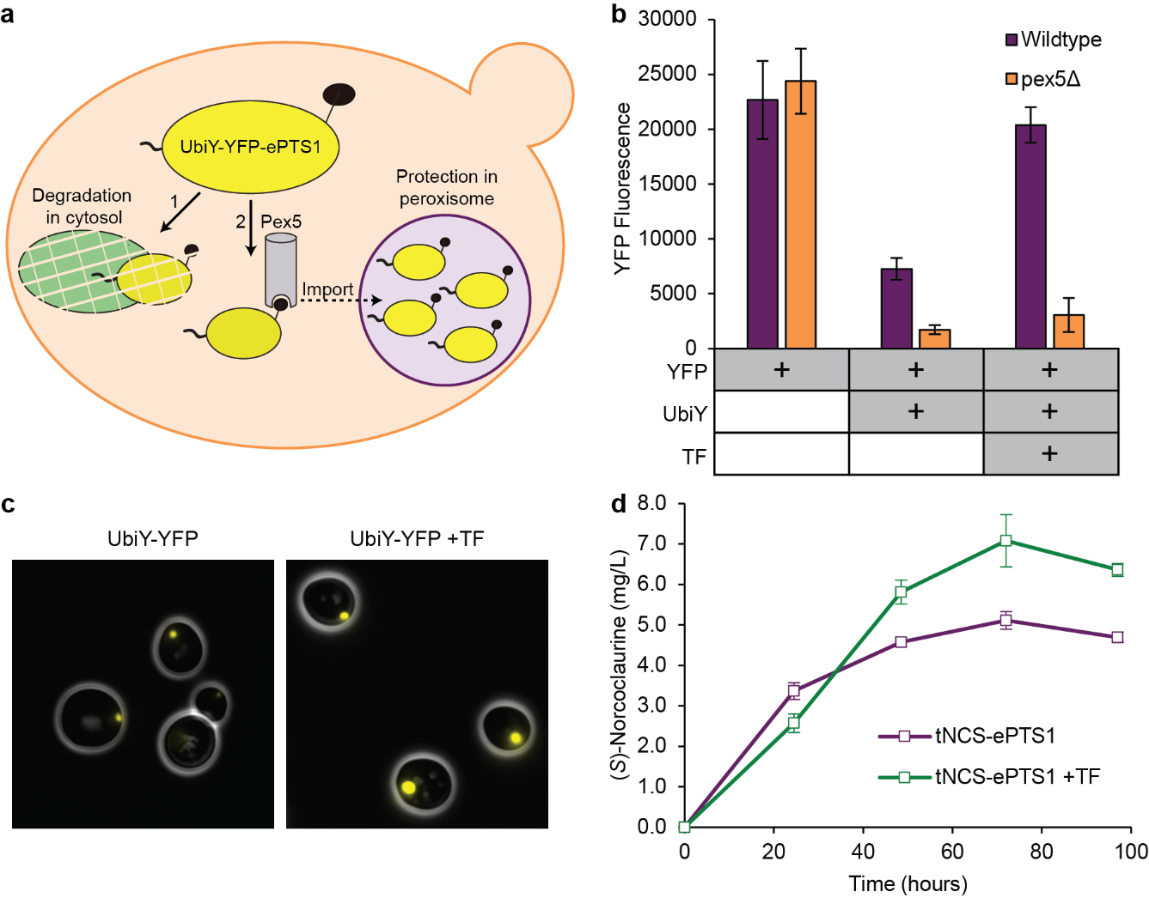
Constitutively Active TFs Provide Larger Capacity Peroxisomes
Transcription factors (TFs) engineered:
Adr1 – glucose derepression
Oaf1 – oleate induction
Pip2 – oleate induction
Grewal, Samson, Baker, Choi, & Dueber. Nature Chemical Biology, 17, 2021: 96-103.

Slide 5
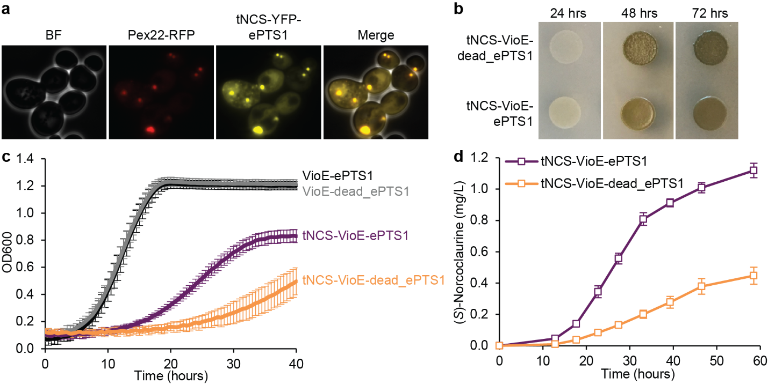
Larger Capacity Peroxisomes Enable Higher Chemical Production
Peroxisome
Cytosol
Valuable chemical, (S)-norcoclaurine, production increases with peroxisome localization
Further increases to production with increasing peroxisome size
Slow growth from expression of engineered TFs
Peroxisome
TF + Peroxisome
Grewal, Samson, Baker, Choi, & Dueber. Nature Chemical Biology, 17, 2021: 96-103.
Notes:
benzylisoquinoline alkaloid (BIA) pathway
Includes ~2,500 natural products with variety of bioactivities (antibacterial, analgesic, anticancer, etc.)- Analgesics include codeine and morphine
Transition to wanting to identify what are the sole components causing the increased peroxisome capacity

Slide 6
Transcription Factor Transcriptomics Reveals Changes to Many Genes
Notes:
Transition to saying we testing some of these highly upregulated ones

Slide 7
Overexpression of Single Genes Doesn’t Match TFs
Mimicking natural oleate induction
Notes:
We want to at least match natural induction, and if we can figure out the mechanisms to get this larger capacity, hopefully we can exceed natural induction.
This is also the case for combining overexpression of two of these genes
Since it’s not change in transcription for a single or a couple of genes, it’s likely a combination of small changes to many genes, so we started doing some rational engineering around organelle biology directed by our transcriptomics results

Slide 8
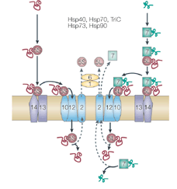
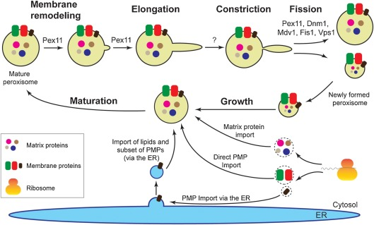
Two Routes to Achieve Highest Capacity Peroxisomes
Higher quantity of larger peroxisomes
(morphology, number, degradation, etc.)
2. Increase protein
trafficking
Pexophagy
Docking complex
Translocation complex
Aksit & van der Klei, 2018; Titorenko & Rachubinski, 2001
Notes:
We know that altering Pex11, either overexpressing or knocking out, can change morphology, few large ones, many small ones, but that doesn’t impact capacity

Slide 9
Expression of Combinations of Pex Genes Matches Natural Induction Capacity
TFs
WT
Import | - | + | - | - | - | + | + | + | -
Translocation | - | - | - | - | + | + | - | - | -
Docking | - | - | + | - | - | - | + | - | -
Biogenesis | - | - | - | + | - | - | - | + | -
TFs | - | - | - | - | - | - | - | - | +
Notes:
Import – Pex 5, 4, 1, 17
Translocation (Pex 2, 10, 12)
Docking – Pex 13, 14, 17
Biogenesis – Pex 3, 28, 29, 34

Slide 10
Knocking Out Pexophagy Genes Increases Peroxisome Capacity

Slide 11
Combining Knockouts and Overexpression Exceeds Natural Capacity
Notes:
Top upregulated – Pex 11,. 28, 5, 14, 12
Import – Pex 5, 4, 1, 17
Translocation (Pex 2, 10, 12)
Docking – Pex 13, 14, 17
Biogenesis – Pex 3, 28, 29, 34

Slide 12
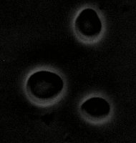
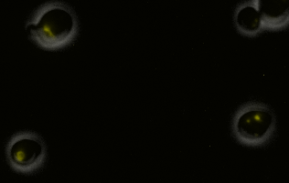


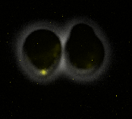

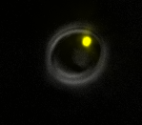


WT
TFs
Pex5,4,1,17
WT – super long exposure
ΔAtg11
ΔAtg11 + Pex5,4,1,17
Notes:
Now that we know we can exceed natural induction, we want to push this even further
All done with same exposure time (3 seconds), except for WT-super long exposure image

Slide 13
Next Steps: Use Machine Learning to Further Increase Capacity
High throughput library overexpression experiment
+
…
…
High capacity
Flow Cytometry
Medium capacity
Sequence
Low capacity
Notes:
Plug that we want to do PacBio, long-read sequencing for this, so if anyone has any experience or capabilities with this, I’d love to chat more.

Slide 14
Next Steps: Use Machine Learning to Further Increase Capacity
Sequencing data + accumulated rational engineering data feeds into machine learning (ML) method
Prediction of genetic changes to find even larger peroxisome capacity
overexpressed genes
(pex1, pex2,…)
knockout genes
(Δpex9, Δpex11,…)
ML algorithms
Slide adapted from Shangying Wang (IBM)

Slide 15
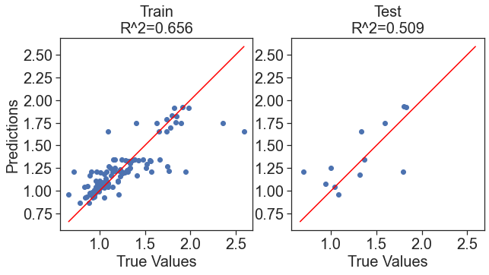
Gradient Boosting Regression (GBR) ML Initial Work
~100 data points from manual, rational engineering experiments (Jordan) fed into initial ML algorithm (Shangying)
“Boosting” in machine learning is a way of combining multiple simple models (a.k.a. weak learners) into a single composite model
“Gradient” in "gradient boosting" comes from the fact that the algorithm uses gradient descent to minimize the loss
Decision trees are used as the weak learners in gradient boosting.
Slide adapted from and work performed by Shangying Wang (IBM)
Notes:
90% train, 10% test
Want to expand into a deep neural network and feed in more data from high throughput library experiment

Slide 16

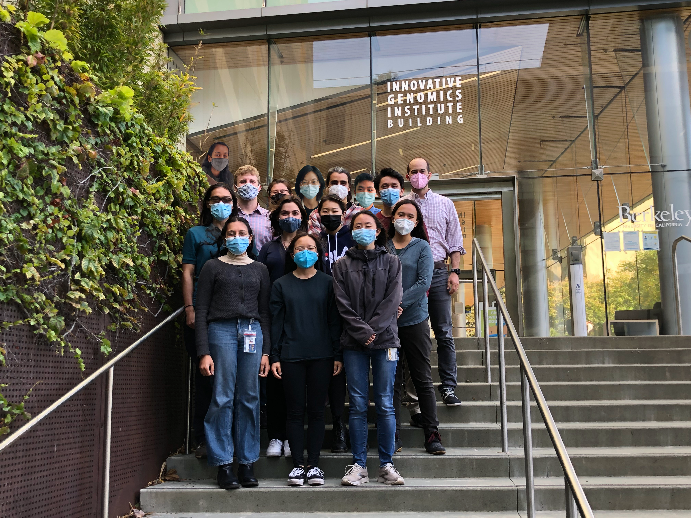

Acknowledgements
John Dueber
Parry Grewal
Kay Siu
Jen Samson
Vicki Lee
Center for Cellular Construction
Shangying Wang
Sara Capponi
Simone Bianco
Anamika Agrawal
Wallace Marshall
Jennifer Fung
Debra Singer
Notes:
This material is based upon work supported by the Center for Cellular Construction, which is a Science and Technology Center funded by the National Science Foundation. Cooperative Agreement AWARD: DBI-1548297

Slide 17
Transcription Factor Transcriptomics Reveals Changes to Many Genes

Slide 18
Import (Pex5, 4, 1, 17) | - | - | - | + | + | + | - | + | -
Translocation (Pex 2, 10, 12) | - | - | + | + | - | - | - | - | -
Docking (Pex13, 14, 17) | + | - | - | - | + | - | - | - | -
Biogenesis (Pex3, 28, 29, 34) | - | + | - | - | - | + | - | - | -
TFs | - | - | - | - | - | - | - | - | +

