Slide 1
Vacuole SiZE-SCALING and Ploidy in S. Pombe
Emily Conrad
Mark Chan Lab, SFSU
CCC Quarterly Meeting December 2021
Notes:
33s

Slide 2
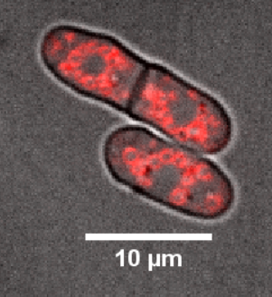
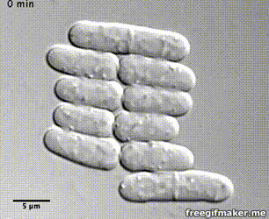
Fission Yeast: S. pombe
Unicellular yeast, cylindrically shaped with semi-circular ends
Divide medially, symmetrically
Cell growth at tips; cell width fixed throughout growth
Diploids almost 2x the volume of haploids
Cell size highly correlated with cell cycle
Haploids begin mitosis at around 15um
Diploids undergo cytokinesis at around 24um
haploid pombe
diploid pombe
Hoffman et al, Genetics 2015
Source: ‘TheMotorProtein’ channel, YouTube; Gif by: Will Chadwick

Slide 3
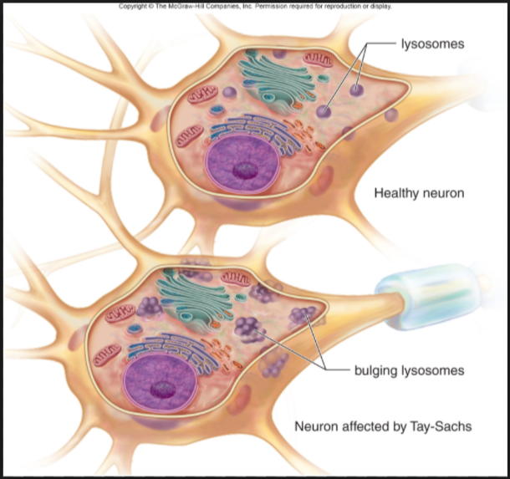
Why Study Vacuole Size?
Altered lysosome-cell size scaling in neurons of person with Tay-Sachs
Organelle size affects organelle function
Vacuole functions in yeast: storage, protein degradation, maintain homeostasis
Organelle size scales with cell size in many cases
ex: nucleus size
Mechanisms of size scaling control not always understood
Vacuole size scaling involves growth rates and membrane trafficking (Chan, 2014 & 2018)
Does DNA content affect vacuole size scaling? Cell volume?
Chan et al, 2014, Biophysical Journal and Chan et al, 2016, Current Biology
Human Biology, McGraw-Hill Education, 2016
Notes:
How does ploidy (DNA content) figure into studying vacuole size, and vacuole size scaling with cell size, and vacuole function
Lysosomal storage disorders
Homology to mammalian lysosome
Proteins not degraded -> lysosome size affected

Slide 4
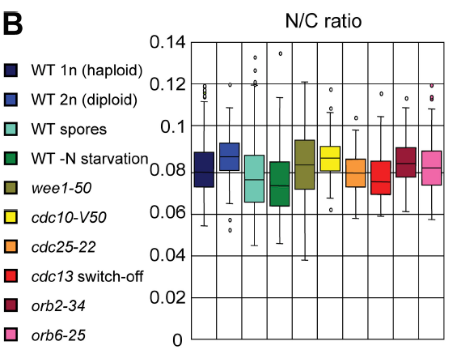
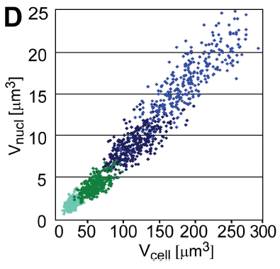
Previous Research: Ratio of nuclear-cell size not significantly different between haploid, diploid pombe
Nuclear to cell size ratio does not significantly differ across large range of cell sizes in pombe
Changes in ploidy do not alter nuclear-cell size ratio
Figures: Neumann and Nurse, J Cell Bio, 2007
Notes:
Points from Neumann paper:
-it is cell volume and not cell length that correlates w nuc size (bc the same ratios found in round and cylindrical cells)
-correlation btw cell, nuc size is linear
-similar to the correlation found in budding yeast
-

Slide 5
Main Question: Will vacuole-cell size scaling differ between haploid and diploid pombe?
Notes:
20s

Slide 6
Predictions
DNA content does not affect organelle size scaling ratios?
Cell size does not affect organelle size scaling ratios?
Vacuole-cell size scaling is not significantly different between haploid and diploid pombe
DNA content affects organelle size scaling differently depending on the organelle?
Cell size affects organelle size scaling ratios?
Vacuole-cell size scaling is significantly different in haploid and diploid pombe

Slide 7
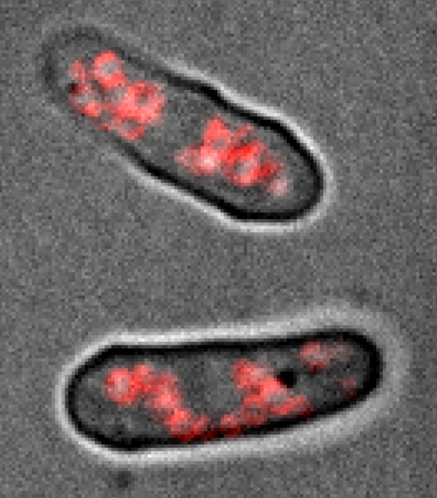
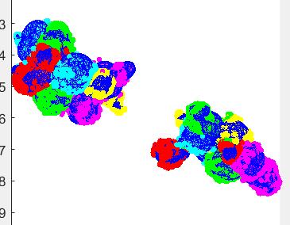
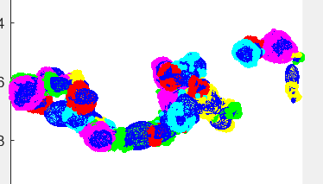
Imaging and Image Analysis Methods
diploid S. pombe – vacuoles stained with FM464
images 1,2: Will Chadwick
Notes:
2m30s

Slide 8
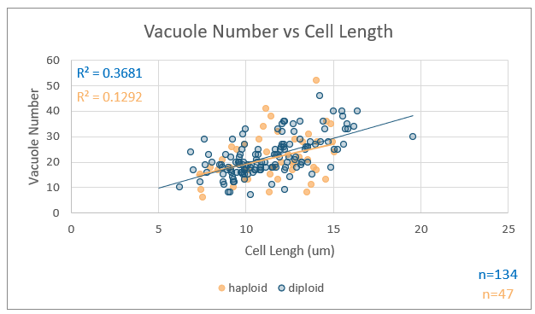
Vacuole Number-Cell Size Ratio Similar in Haploid and Diploid Cells
Vacuole number increases with cell size
Both ploidies have similar vacuole number-cell size ratios
Unexpected: diploid cell length covers same range as haploid cell length!
Did not realize diploid cells are wider than haploid
~1.25x wider (Hoffman, 2015)
Hoffman et al, Genetics 2015
Notes:
2m30s
-I counted more vacuoles than Will,

Slide 9
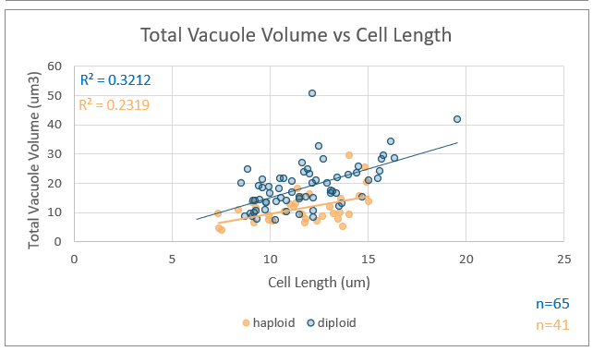
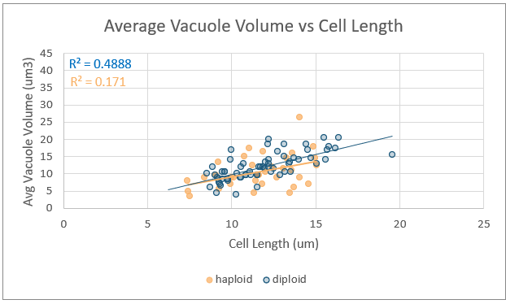
Vacuole Volume-Cell Size Scaling: Similar or Distinct Trends?
Total vacuole volume-cell size scaling appears different in haploid, diploid pombe
Average vacuole volume-cell size scaling ratios appear maintained
Cell length ≠ good measure of cell size since cell widths are different

Slide 10
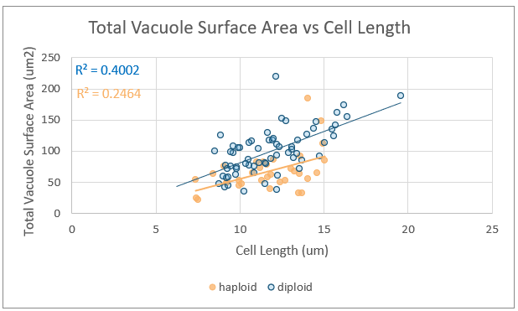
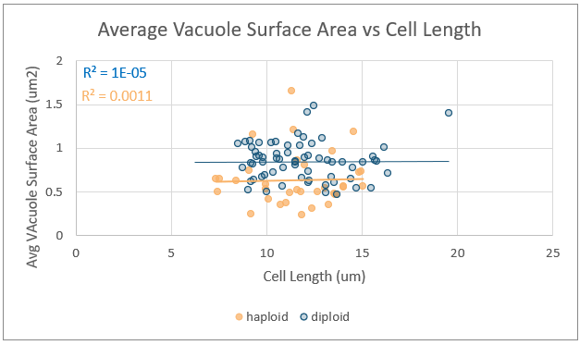
Vacuole Surface Area-Cell Size Scaling: Similar or Distinct Trends?
Total vacuole surface area-cell size scaling – how to interpret?
Average vacuole surface area-cell size ratio does not change with cell size in either ploidy.
R² higher in diploid vs haploid cells – why?
Notes:
Total vacuole volume-cell size scaling appears different in haploid, diploid pombe
Average vacuole volume-cell size scaling ratios appear maintained
Cell length ≠ good measure of cell size since cell widths are different

Slide 11
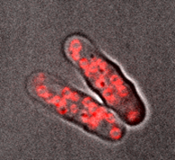
Future Directions
Calculate more accurate cell size using cell lengths, average widths?
Investigate agreement between vacuole number, vacuole volume and surface area calculations
Learn more about organelle-size scaling in other organelles with multiple copies (mitochondria? peroxisomes?) – similar or different across range of cell sizes?
Look at size scaling trends in cells connected by septum and in mitotic cells

Slide 12
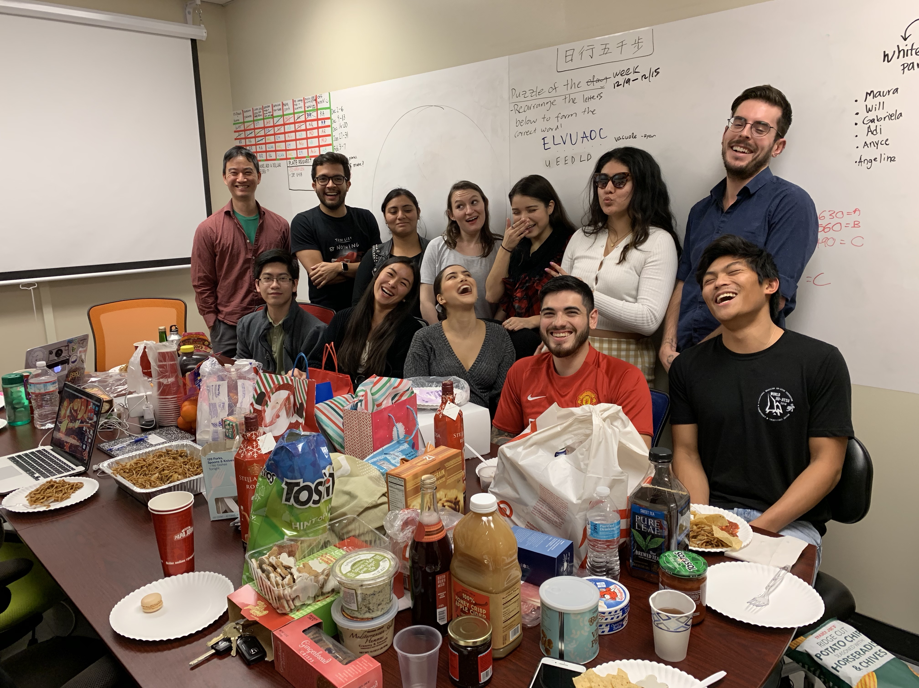
Thank You for Your Support!
Mark Chan
Annette Chan and the CMIC
Blake Riggs
Sally Pasion
Chan Lab Members
(Current and Former):
Gabriela Alvarez Azanedo
Ryan Acbay
Ramon Rodriguez
Brenda Garibay
Anyce Godoy
Nelson Menjivar
Daniel Knapp
Jasmine Sims
Will Chadwick
Angeline Chemel
Thanh Quach
Adrian Barrera-Velasquez
Raquel Racelis
Maura De Jesus
Adilene Rodriguez
Roberto Carlos Segura

Slide 13
Presentation Overview
Brief Background
Previous Research Leading up to My Question
Central Question
Hypothesis
Current Results
Difficulties with Interpreting Results!
Future Directions
Questions
Notes:
1m

Slide 14
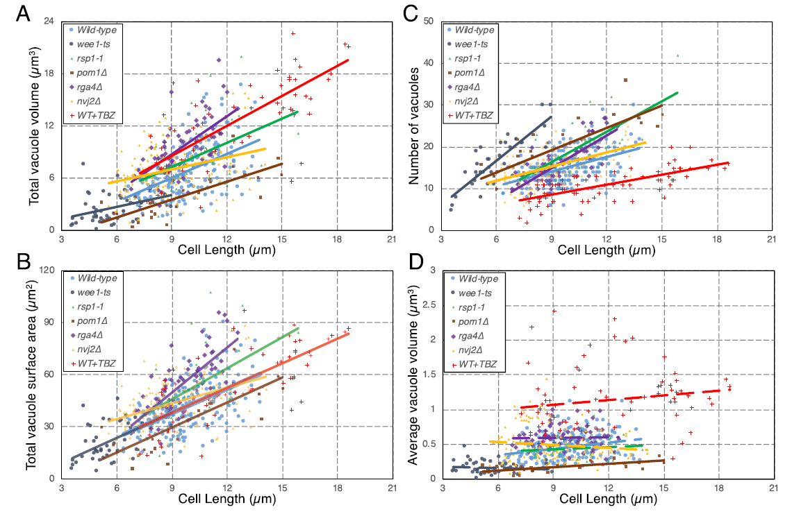

Slide 15
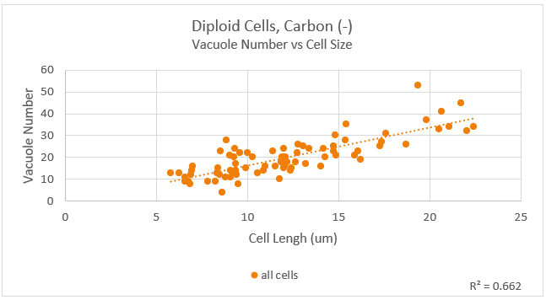
More Results

Slide 16
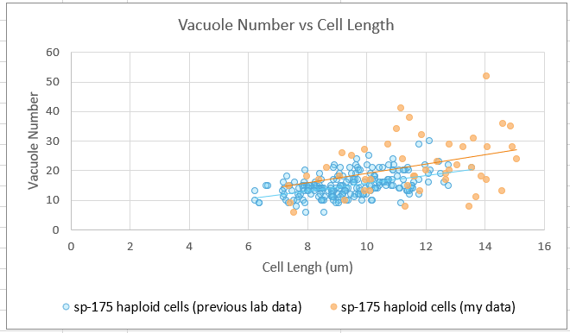
More Results

Slide 17
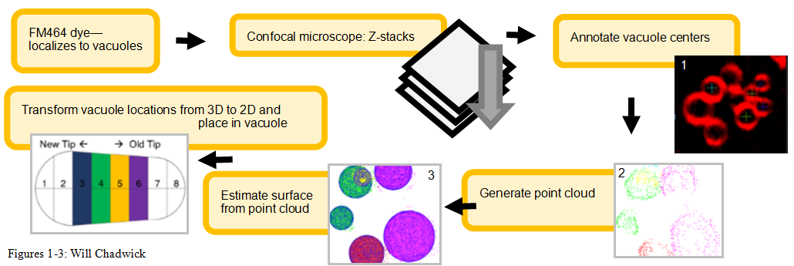
Methods

