Slide 1
CCC Summer Internship
Target Product Profile development for the µDicer
Seth Cordts, Saisneha Koppaka
Advisor: Sindy Tang, Ph.D. Stanford
Mentor: Charles Hart, Ph.D, UCSF Catalyst Program Director

Slide 2
Outline
Target Product Profile (TPP)
μDicer Description
μDicer TPP
Summary
Notes:
Sai

Slide 3
Summer Internship Program
Target Product Profile (TPP)
In industry, target product profiles (TPPs) are used as planning tools that guide development towards desired characteristics
In the regulatory context, TPPs serve as the framework for discussions between the FDA and the sponsor
In the context of public health, TPPs set R&D targets for funders and developers
Notes:
Sai

Slide 4
Target Product Profiles (TPP)
Focus of the Summer Internship Program
A target product profile (TPP) has detailed description of what features and attributes a product has to harbor to be successful
Embodies “beginning with the end goal in mind”
Includes the scientific, technical, clinical, and business and market information that is required to achieve a desired commercial outcome
It identifies the optimal and minimal product attributes. These will be the thresholds that you will use to determine if your candidate’s performance metrics are acceptable to continue moving forward with it
It is a dynamic document that should be reviewed throughout the development process
Notes:
Sai

Slide 5
Catalyst Award Target Product Profile
Therapeutics Project
Medical Device Project
Product Description
Indication
Unmet Clinical Need
Competitive Landscape
In vitro Biochemical Activity
In vitro Cell-Based Activity
ADME/PK
Tox and Safety
In vivo Efficacy
Clinical Trials
Intellectual Property
Regulatory Path
Reimbursement
Market Opportunity
Product Description
Unmet Clinical Need
Competitive Landscape
Target Market or Customer
Product Profile Requirements
Manufacturing standards required
Intellectual Property
Manufacturability
Economical value
Human factors to consider
Stability
Validation studies
Desired licensing outcome
Notes:
Sai

Slide 6
The Technology: µDicer summary
Notes:
Seth

Slide 7
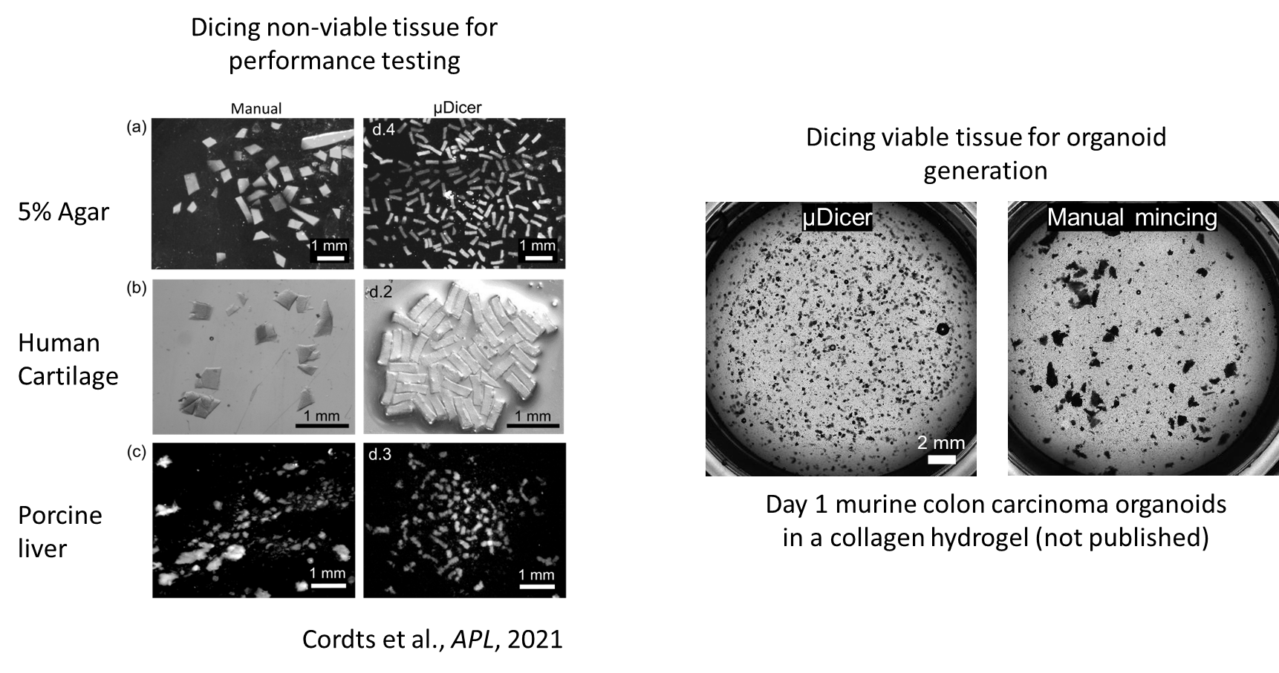
The Technology: µDicer summary
Notes:
Seth

Slide 8
Possible markets
Instrumentation
Sell the µDicer as a tool for researchers to use.
Cell/Tissue products
Sell the processed tissue
Contract research services
Drug response data to client-supplied live tissue samples
Spatial-omic information from client-supplied tissue.
Notes:
Seth

Slide 9
2a. + 3a. Organoid sales and testing
Companies in the segment
Company | Product | Description | Pros/cons/limitations | What is their product
Sage Medic | Sage direct platform | Directly testing live tissue biopsies for drug treatments | Not for sale yet Limited information on website. | Information
InSphero | 3D inSight | Assay-ready 3D spheroids in 96 or 384 well plate delivered to researchers for testing. Standardized tissue models for tumor, healthy, or disease states, or PDX-derived tumor models. | - Ease of use for the researcher (mail to order sphereroids) - Does not recapitulate the microenvironment entirely - cellular self-assembly to make spheroids | QC’ed Spheroids in plated format.
Visikol | 3D culture assay services and development | They sell a variety of standard assays in addition to consultation services for developing client-specific assays. | - They have a large variety of products and services. They claim they will help develop assays for the client if they don’t already offer it. | - Expertise/consulting -information
Xilis | MicroOrganoSphere(MOS) | Patient-derived micro-tumor analysis. Maintaining tissue structure, gene expression, immune microenvironment, and histopathology. | - Droplet encapsulation to grow up organospheres - They claim they can predict drug response within 14 days. - Machine learning tools to track and measure organospheres over time. | - Not for sale yet -
ImpriMed
Notes:
Seth

Slide 10
3b. Spatial-omic information from client-supplied tissue.
Companies in the segment
Company | Product | Product Description | Pros/Cons/Limitations
10x Genomics | Visium | FFPE/frozen sections(6.5mm x 6.5 mm) of tissue placed onto a prepared gene Visium expression slide and imaged for histology. Each ‘capture area’ hasan array containing probe that bind to RNA ⇒ whole transcriptome analysis. 55um diameter ‘capture area.’ 100um center to center 1-10 cell resolution | Pro: Single cell + data analysis package. Con: Starting with frozen/FFPE tissue samples; need to start with small tissue fragment
NanoString | GeoMx Digital | FFPE/frozen tissue passed through tissue microarray (TMA).Strain for RNA or spatial protein information | Pro: complete analysis package provided Con: Starting with fresh frozen/ FFPE tissue samples
S2 Genomics | TissuePrep | Tissue-specific enzyme formulation or nuclei formations break down solid tissue single cell/single nuclei | Pro: Automated single cell + nuclei suspension Con: Solid Tissue
Pro/ Market Gap: Processed tissue in wells (maintains the spatial distribution) and can be processed using existing sequencing analysis that’s not limited to RNA .
Notes:
Seth

Slide 11
Product Description
Product: Tissue processed with the μDicer. Microtissues retaining in vivo ECM and cellular heterogeneity for organoid applications.
Description:
Tissue can be in either 50/100/200/400 μm uniform fragments, as per the customer’s request.
Can start from biopsy sample size or larger
Gap/Need:
Uniform tissue fragments generated from tissue samples.
Increased viability of cells from fresh tissue samples.
Organoids used for fundamental analyses including, but not limited to, RNA-based analysis.
Our product offers the flexibility in how tissue fragments can be used.
Notes:
Sai

Slide 12
Competitive Landscape (‘Pre-packaged’ Organoids)
ATCC/ HCMI website
Partnered with the Human Cancer Model Initiative to sell 2-D and 3-D patient-derived cancer models
Frozen organoids models are purchased, thawed, and reseeded into well-plates with ECM media
Limitations: Frozen, Organoids do not contain stromal or immune cells to fully capture the TME
Sigma-Aldrich website
Sell cryopreserved PDOs
Only offer intestinal organoids currently
StemCell website
Only offer mouse hepatic and intestinal organoids
Notes:
Sai

Slide 13
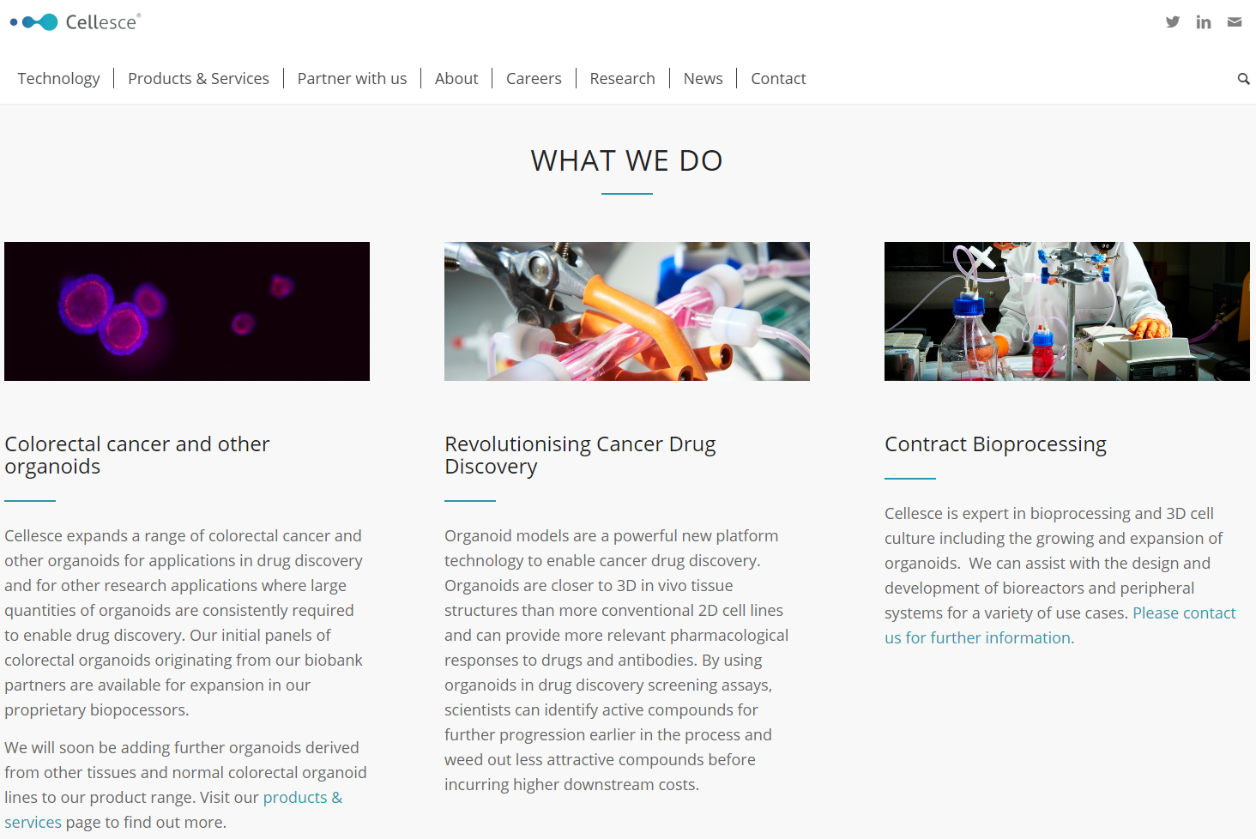
Cellesce
Company in UK
Sell organoids
Service to produce organoids from supplied patient tissue
Drug screening services
Their technology is a bioreactor for generating/expanding organoid cultures.
Notes:
Seth

Slide 14
Long list of companies in organoid/spheroid space
3D Biomatrix
3D Biotek LLC
AMS Biotechnology (Europe) Limited
ATCC
Cellesce Ltd.
Corning Incorporated
Greiner Bio-One
Hubrecht Organoid Technology (HUB)
InSphero/Perkin Elmer
Kuraray
Lonza
Merck KGaA
Prellis Biologics
STEMCELL Technologies Inc.
Thermo Fisher Scientific, Inc.
From Grand View Research report Aug. 2020
https://www.grandviewresearch.com/industry-analysis/organoids-spheroids-market
Notes:
Seth

Slide 15
Target Market
Who is the customer?
Pharma companies (Third-party drug development companies)
While parma companies do not have significant in-house drug development (only about 10% of early stage drug discovery of 2017 took place in J&J/ Pfizer), they often acquire smaller third-parties. Third-parties accounted for >86% of the Pfizer’s 2017 revenue.
‘Precision medicine’ is one of the top 10 growing sectors of pharma companies
Academic researchers
Fundamental research
Organoid/spheroid companies that currently grow organoids from single-cells
Notes:
Sai

Slide 16
Product Profile Requirements
Manufacturing standards
% Viability guarantee
Cell profile
Consistent genetic profile and expression levels for standard samples
Uniformity of size
ISO 9001 (Quality management)
ISO 13485 (Medical device quality management)
ISO/IEC 17025 accreditation (Competence of testing and calibration laboratories)
ISO 17034 (Competence and consistent operation of reference material producers)
(Based on ATCC and StemCell)
Notes:
Sai

Slide 17
Economic Value
Primary cell culture and organoid/spheroid markets gauge our economic value.
Primary Cell Culture Market Size report (April 2021) [Grand View Research, 2020]
Valued at USD 3.4 billion in 2020
Expected to expand at a compound annual growth rate of 11.6% from 2021 to 2028.
Growth is attributed to increasing research initiatives for cancer and rare diseases.
Mechanical separation is expected to witness lucrative growth over owing to its large adoption as ainexpensive, quick, and easy method for disaggregation of cellular entities.
Organoid and Spheroid market size report (Aug 2020) [Grand View Research, 2020]
Valued at USD 405.3 million in 2019
Expected to grow at a compound annual growth rate of 22.5% from 2020 to 2027.
Notes:
Seth

Slide 18
Summary/Conclusion
Product Description
μDicer
Unmet Clinical Need
Flexibility in how uniform tissue fragments/single cells can be used in organoid generation
Competitive Landscape
ATCC/Sigma- Aldrich/Stem Cell/Cellesce
Target Market or Customer
Third party drug development/ Academic research
Product Profile Requirements
Viability/consistency/uniformity of product
Manufacturing standards required
ISO requirements
Economical value
Single cell: $3.4 billion + Organoid: $405 million
Notes:
Seth

Slide 19
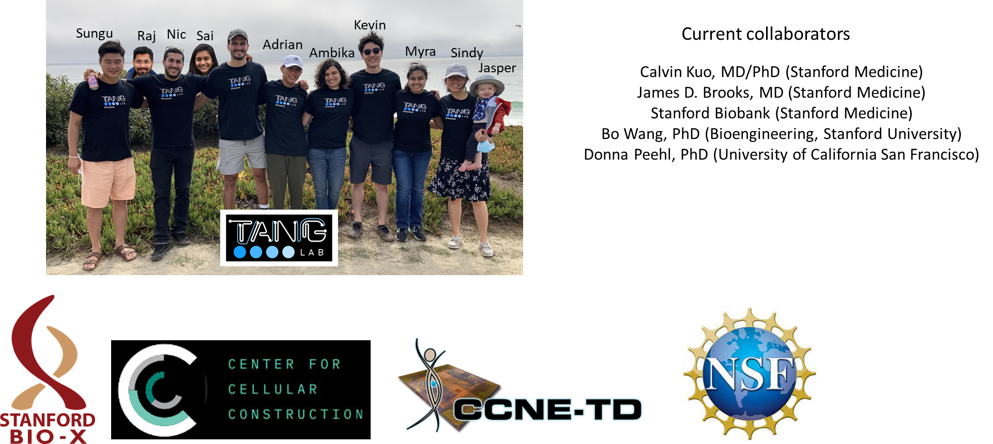
Acknowledgements
We want to thank Charles Hart for his mentorship!

