Slide 1

Finding & Utilizing Core Facilities at UCSF
Research Resource Program
Rochelle Kelley, Program Manager

Slide 2
The Research Resource Program (RRP)
Our Mission is to enable access to state-of-art and essential technologies that facilitate cutting edge research at UCSF through support of core laboratories and other shared resources.
Roughly 60 cores are available at UCSF on different campuses
One of the most frequently accessed tools is the scheduling and request platform, iLab (Developed by Agilent Technologies)
We provide operational and financial support to cores through a host of services and programs including recharge maintenance, core visibility opportunities and grant programs in collaboration with the Research Development Office (RDO)
Notes:
Log in to iLab
Equipment Schedule
Updating pricing information
View All Request
Edit service request status
Toggle active request
Creating a tab
Billing
Expired Speedtype: What to do when a speedtype has expired or nearing expiration
Use the messaging button to request a new speedtype, if is nearing expiration a new one will also need to be requested. Any speedtype expiring within the month of the reservation will not be valid.
What to do when a lab member is no longer part of the lab?
Resubmit request under PI
What if a customer provides updated billing information for several reservations that have already been confirmed?
PO & IOC
Core Visibility
People Tab
Advance messaging
-Notices, new equipment coming online,
-apply filter to display people who have used the equipment
-insert image URL
Reporting:
-reporting events. Usage hours for equipment, cancellation, reservation hours etc.
-Charges
-Services
Source data = MyCores extract
Data from charts/tables = exactly what you see on screen in excel format
Equipment & Service classification
Questions

Slide 3
What are the Advantages of using Cores?
Share the cost of expert personnel and cutting-edge technology
As technologies get more expensive and more complicated, cores become more pertinent
Provide access to technologies too expensive for individual labs
Core scientists provide expert training and advice on experimental design, data analysis and interpretation
Training on new or existing technologies for future self use in core facilities
Notes:
Log in to iLab
Equipment Schedule
Updating pricing information
View All Request
Edit service request status
Toggle active request
Creating a tab
Billing
Expired Speedtype: What to do when a speedtype has expired or nearing expiration
Use the messaging button to request a new speedtype, if is nearing expiration a new one will also need to be requested. Any speedtype expiring within the month of the reservation will not be valid.
What to do when a lab member is no longer part of the lab?
Resubmit request under PI
What if a customer provides updated billing information for several reservations that have already been confirmed?
PO & IOC
Core Visibility
People Tab
Advance messaging
-Notices, new equipment coming online,
-apply filter to display people who have used the equipment
-insert image URL
Reporting:
-reporting events. Usage hours for equipment, cancellation, reservation hours etc.
-Charges
-Services
Source data = MyCores extract
Data from charts/tables = exactly what you see on screen in excel format
Equipment & Service classification
Questions

Slide 4
iLab Log in & Live Tour
Logging in:
Go to https://ucsf.ilab.agilent.com/account/login
  Two ways to connect, either through MyAccess OR by contacting iLab@ucsf.edu – Be sure to inform of CCC/Wallace Lab affiliation
  Bookmark this URL for future use
iLab Live Tour – Searching Core Facilities

Slide 5
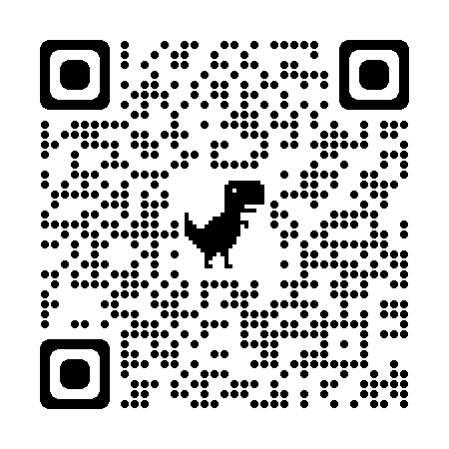
Resources
RRP Website: https://rrp.ucsf.edu/
iLab Support Teams- Service Ticket Protocol
Upcoming training events: iLab Office Hours
Core Search: https://rrp.ucsf.edu/core-services
For further assistance please contact iLab@ucsf.edu
Quick Start Guides:
  https://rrp.ucsf.edu/ilab-user-training

