Slide 1
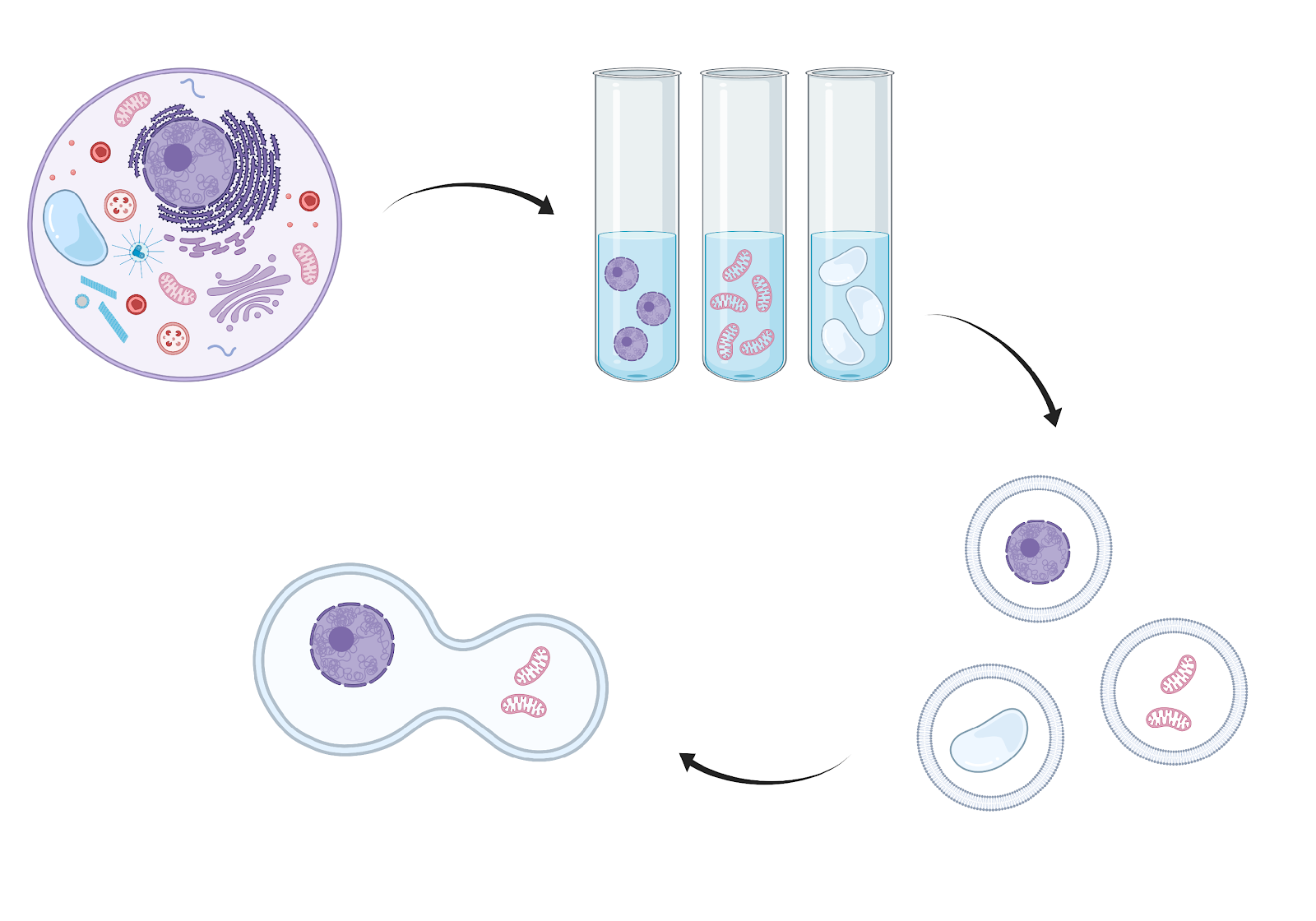
CCC Symposium:
Reconstitution of Organelle Interactions: Towards Synthetic Cell Biology
March 3-4, 2022
Thursday, March 3, 2022
Virtual talks and panel discussion
Maya Schuldiner (Weizmann Inst)
Shankar Mukherji (Wash. U. St. Louis)
Mike Henne (UT Southwestern)
Will Prinz (NIH)
Kerstin Göpfrich (Max Planck Inst)
Matt Good (U Penn)
Dora Tang (Max Planck Inst)
Kristina Ganzinger (AMOLF)
purification
encapsulation
Friday, March 4, 2022
In-person poster session & discussion
Call for abstracts coming soon!
fusion

