Slide 1

Toxic chemicals and Burning Planet
Tracey Woodruff, PhD MPH

Slide 2
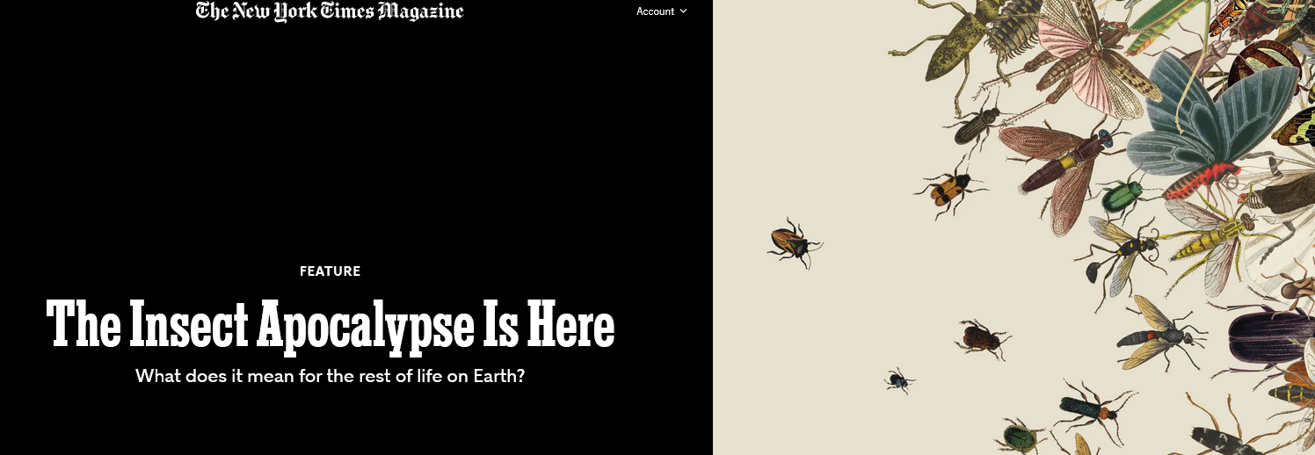

Our Children Could Be Healthier
2017Source: NIEHS/EPA Children’s Environmental Health and Disease Prevention Research Centers Impact Report
Science • 4 Oct 2019 • Vol 366, Issue 6461 & Nature volume 574, pages 671–674 (2019) -
Notes:
Talking points:
- One major reason why those production trends are so alarming is that in the U.S., there are simultaneously increasing trends in chronic health conditions
- Specifically among children, we're observing greater rates of leukemia, asthma, and autism spectrum disorder
- And we know that genetic variation can only explain a relatively modest fraction of disease incidence

Slide 3
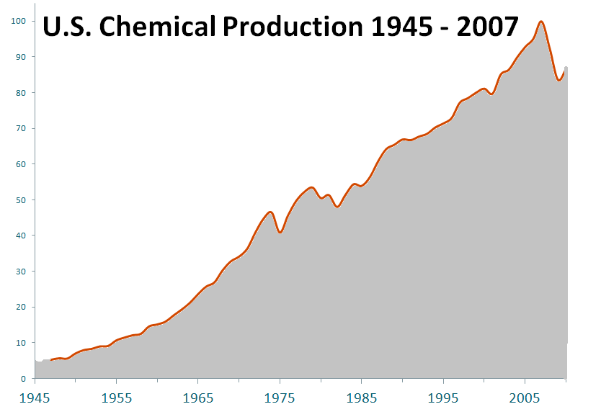
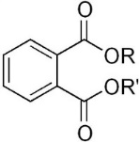
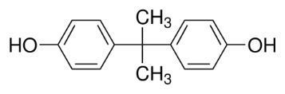
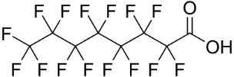

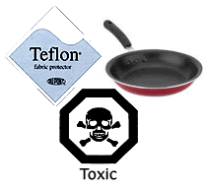



Production compared to the year 2007
↑ 15
fold
Source: U.S. Federal Reserve Board, Division of Research and Statistics
Notes:
Talking points:
- This figure illustrates the magnitude of the problem across an extensive time horizon
- The y-axis here indicates the historic relative production volume, and in 2007, production of chemicals were in up to 15 fold higher than what was estimated in 1945
- And these chemicals are in several consumer products, we've highlighted a few examples:
- polyflourinated compounds used in teflon and cookware
- polybrominated compounds used as flame retardants in furniture
- Phthalate diesters incorporated into plastics, including baby toys
- and phenolic compounds that constitute several food container materials

Slide 4
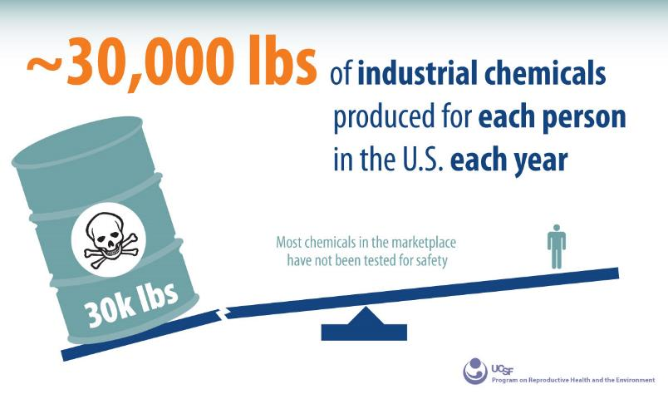


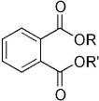


PFAS
Flame Retardants
Phthalates
Phenols
EPA Chemical Data Reporting 2015

Slide 5
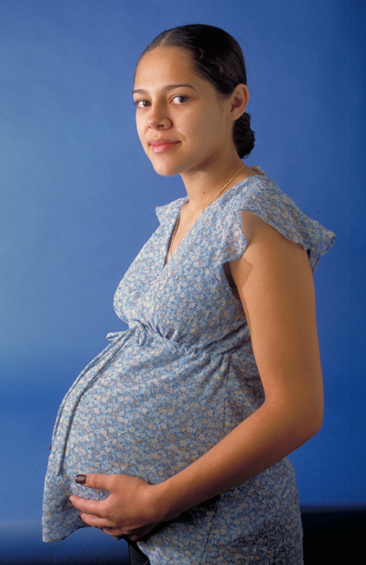

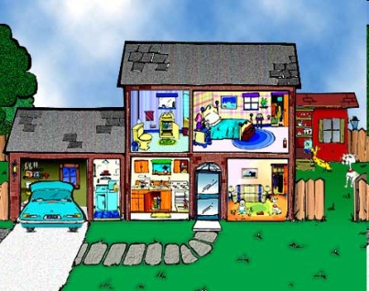
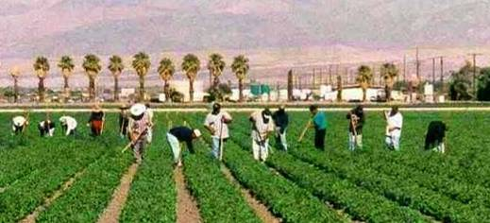

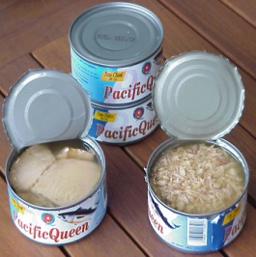
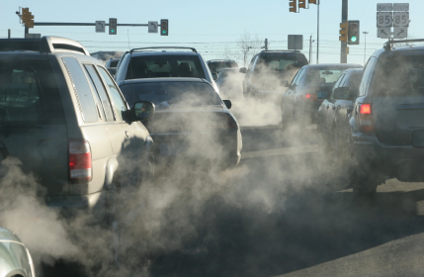


Slide 6
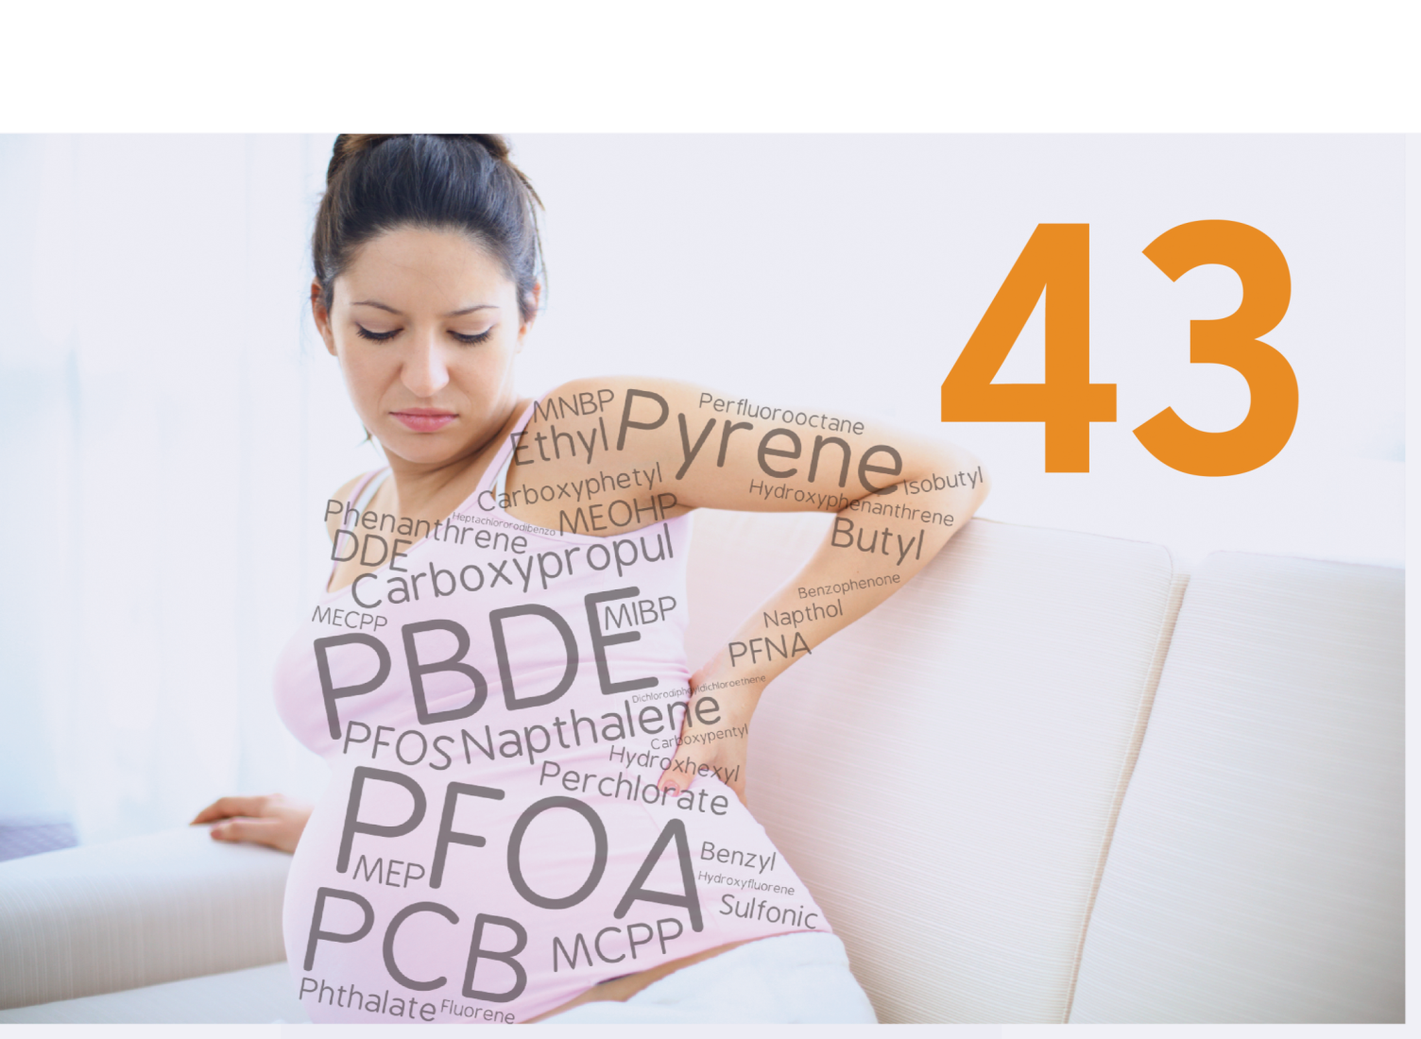
Exposures start in utero to Toxic Chemicals

Slide 7
… “ to a disturbing extent, babies are born pre-polluted.”
National Cancer Institute

Slide 8

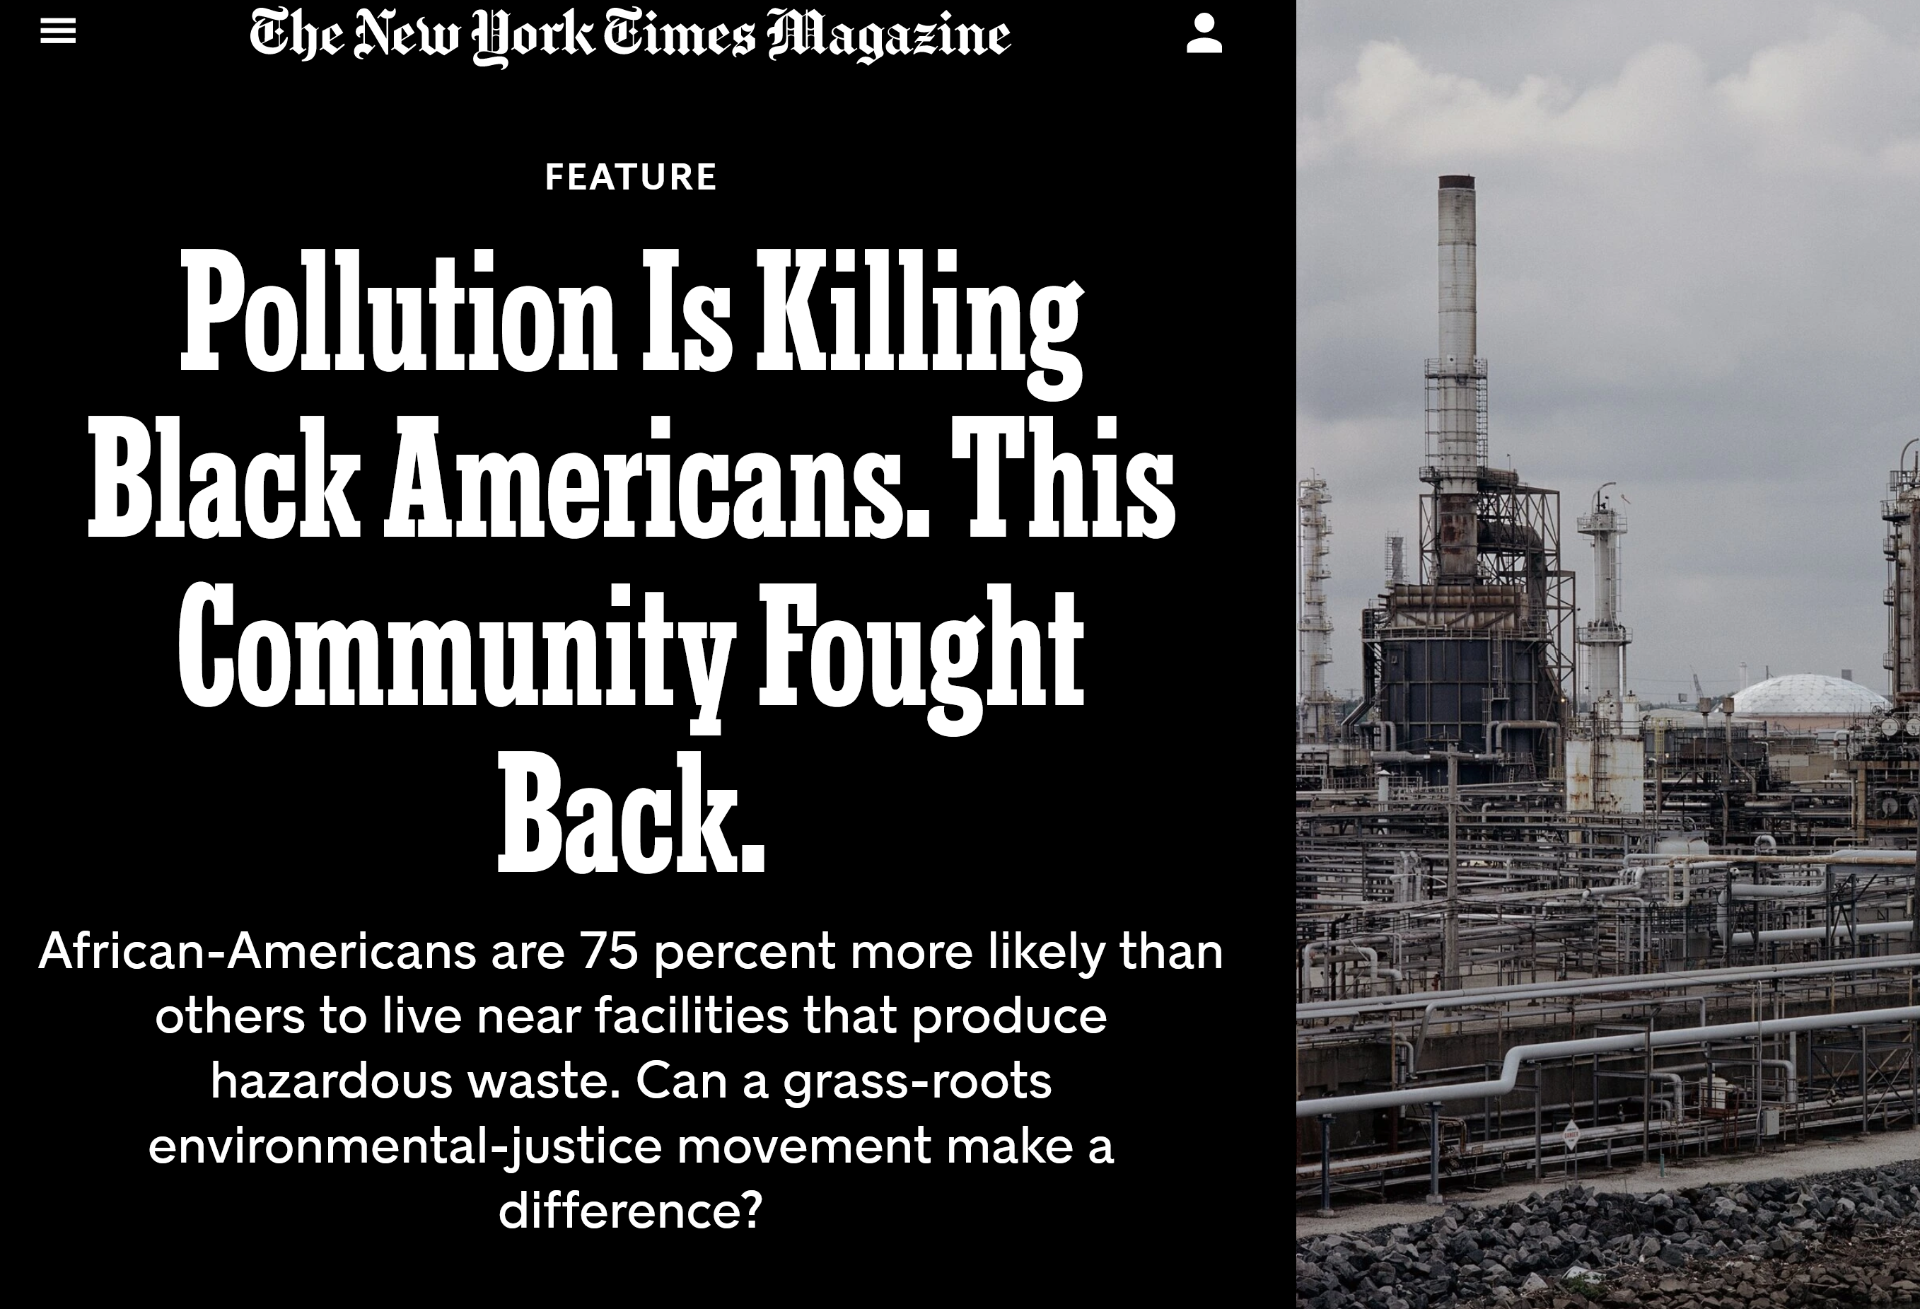
ACOG/ASRM Committee Opinion
Exposures are not equal
Underserved and communities of color have higher exposures/environmental racism
Higher occupational exposures
ACOG Committee opinion - https://prhe.ucsf.edu/sites/g/files/tkssra341/f/wysiwyg/Exposure%20to%20Toxic%20Environmental%20Agents.pdf
Notes:
Although harmful exposure to environmental toxic agents is ubiquitous among all patient populations, many environmental factors harmful to reproductive health disproportionately affect vulnerable and underserved populations and are subsumed in issues of environmental justice. For example, in the United States, minority populations are likely to live in the counties with the highest levels of outdoor air pollution.
Although exposure to toxic environmental agents is widespread across populations, many environmental factors that are harmful to reproductive health disproportionately affect underserved populations and are subsumed in issues of environmental justice 9. In the United States, individuals in communities of color are more likely to live in counties with the highest levels of outdoor air pollution 10 11 and to be exposed to a variety of indoor pollutants, including lead, allergens, and pesticides, than white populations 12.
In addition, the effects of exposure to environmental chemicals can be exacerbated by injustice, racism, poverty, neighborhood quality, housing quality, psychosocial stress, and nutritional status 12 13 14.
Individuals with occupational exposure to toxic chemicals are additionally vulnerable to adverse reproductive health outcomes because of the risk of higher exposures in the workplace 15. For example, levels of organophosphate pesticides and phthalates (often used in plastics) measured in occupationally exposed populations are far greater than levels measured in the general population 16 17. Immigrant populations working low-wage labor disproportionately work in occupations associated with a hazardous workplace environment in relation to toxic chemical exposures 18 19.
A 2009 report by the National Academy of Sciences underscores that the effects of low-dose exposure to an environmental contaminant may be quite different based on characteristics such as the underlying health status of the population and the presence of additional or background environmental exposure 20.

Slide 9
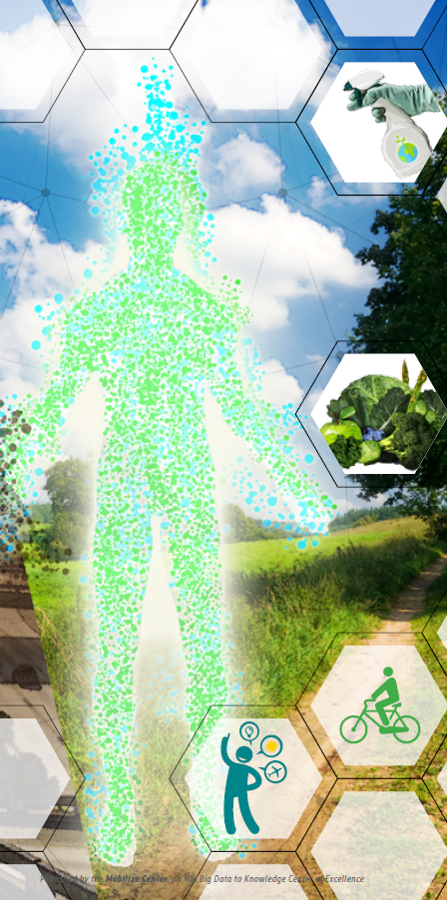
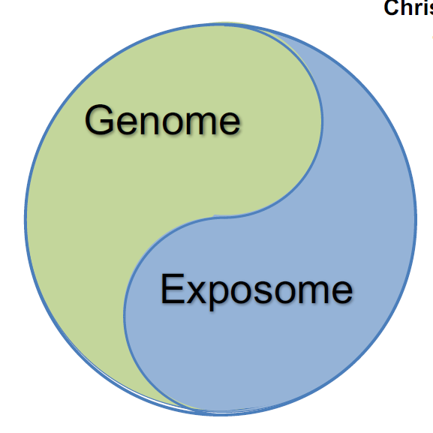

Christopher Wild (2005): Complementing the Genome with an Exposome
Opportunity to Understand and Address Environmental Contributors to Disease
Exposome encompasses:
the totality of human environmental exposures
from conception onwards
Picture source: D.P. Jones, Yale symposium presentation 2017; Jessica Young's FYC6230 Blog; K. Sainani, BCR 2016

Slide 10

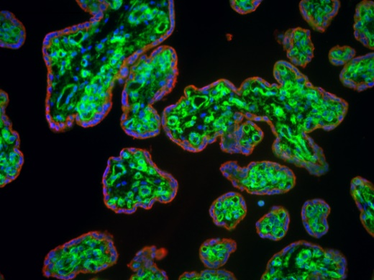
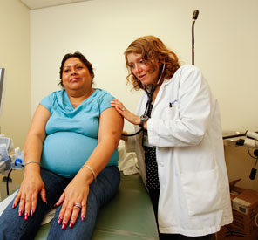
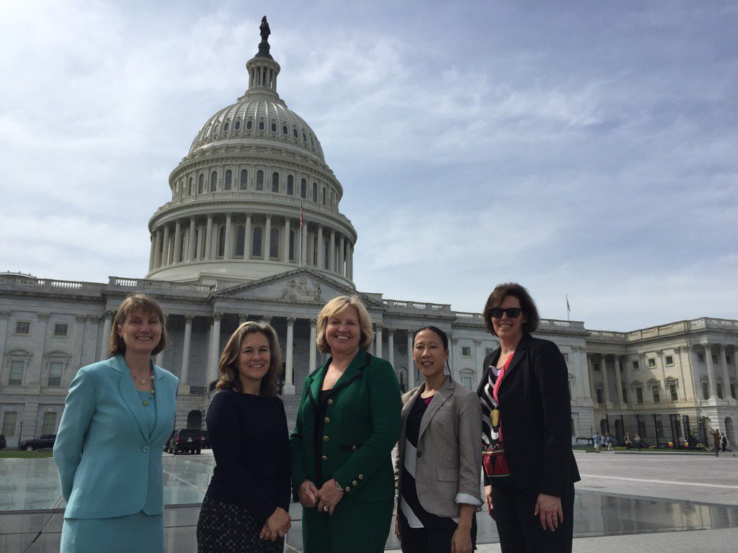
Toxic Chemical Exposures Start in the Womb
Widespread pollutant exposure – opportunity for intervention
RESEARCH
CLINICAL ENGAGEMENT
POLICY
Notes:
In our previous work, we have evaluated chemical exposures among pregnant women using the NHANES 2003-2004 data and found that virtually all pregnant women in the US are exposed to at least 43 different chemicals (out of the 163 chemical analytes). U.S. pregnant women: 43+ ; S.F. pregnant women: 25 (>LOD)

Slide 11
Anthropogenic Change and Planetary Boundaries
Rockström, J., Steffen, W., Noone, K. et al. A safe operating space for humanity. Nature 461, 472–475 (2009). https://doi.org/10.1038/461472a

Slide 12

Mission: Transforming the approach to studying harmful environmental pollutants that undermine health and human development and contribute to chronic disease and health inequities
Notes:
TRACEY

Slide 13
EaRTH Center Goal
To solve the growing burden of chronic disease by accelerating the pace of identifying and preventing harmful environmental exposures that undermine health, reproduction, and human development.
Create new research opportunities in environmental health at UCSF
Nurture and sustain transdisciplinary collaborations
Mentor and grow the next generation of research and clinical leader
Embed environmental health literacy within healthcare
Notes:
Tracey
The overall goal of the University of California, San Francisco (UCSF) Environmental Research and Translation for Health (EaRTH) Center is to accelerate the pace of recognizing and preventing environmental exposures that affect reproduction and development to improve human health across the lifespan.
The EaRTH Center will provide infrastructure, support, and training for a collaborative transdisciplinary network of researchers, clinicians, and learners across UCSF
toward the goal of reducing the growing burden of chronic diseases by identifying and preventing harmful environmental exposures that take place during critical windows, including but not limited to early development and childhood.
This lifespan scope includes environment exposures in workplaces (i.e., occupational health) and aging populations.

Slide 14
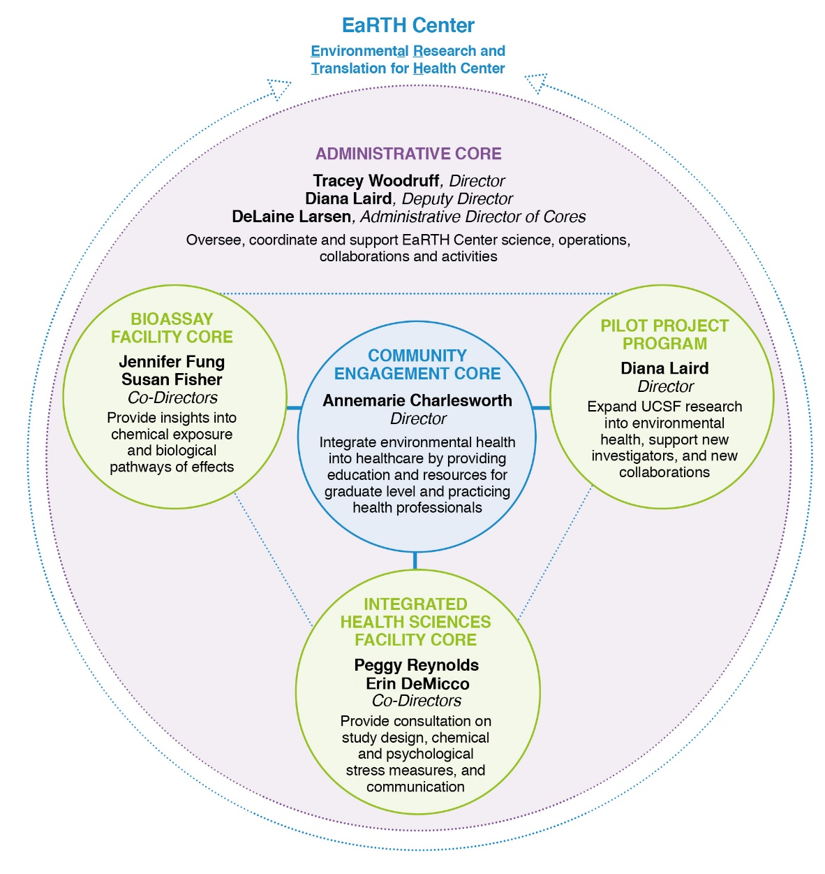


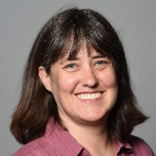


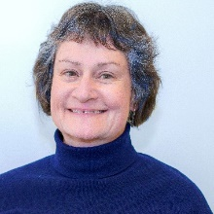
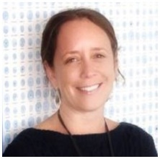


Alana D’Aleo, Center Administrator
Tracey
Woodruff
Diana
Laird
DeLaine
Larsen
Annemarie
Charlesworth
Jennifer
Fung
Susan
Fisher
Erin
DeMicco
Peggy
Reynolds
Alana
D’Aleo
Executive Committee
meets biweekly
Notes:
Annemarie
The EaRTH Center is comprised of 4 Cores and a Pilot Project Program.
Explain Admin and the rest will be explained later in the presentation.
Administrative Core (Director Dr. Woodruff).
This core will nurture, support, and coordinate the key functions of the Cores and Pilot Projects Program to enhance the functioning of the EaRTH Center.

Slide 15

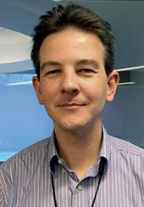
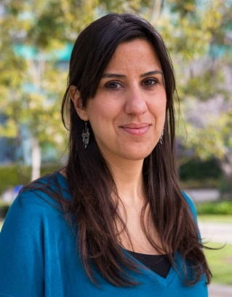

Pilot Project Awardees
Amy Padula, PhD
Associate Professor, UCSF
Dept. of Ob/Gyn & Reproductive Science
Stephanie Gaw, MD, PhD (co-I)
Joshua Robinson, PhD (co-I)
ENVIRONMENTAL HEALTH PILOT PROJECT
"Wildfire smoke in pregnant people in San Francisco Bay Area"
Aras Mattis, MD, PhD
Assistant Professor, UCSF
Dept. of Pathology
Joshua Robinson, PhD (co-I)
ENVIRONMENTAL HEALTH PILOT PROJECT
"Environmental Chemical Exposures and Fetal Liver Developmental Toxicity”
Raquel Chamorro-Garcia, PhD
Assistant Professor, UC Santa Cruz
Department of Microbiology and Environmental Toxicology
ENVIRONMENTAL HEALTH PILOT PROJECT
"Proteomic profiling of primordial germ cells upon preconception exposure to environmental factors”
Max Aung, PhD, MPH
Associate Research Scientist, UCSF
Dept. of Ob/Gyn & Reproductive Science
CANCER & ENVIRONMENTAL HEALTH PILOT PROJECT
"Multi-pollutant profiles of hormonally mediated cancers and endogenous hormones in men and women”
Notes:
DIANA

Slide 16
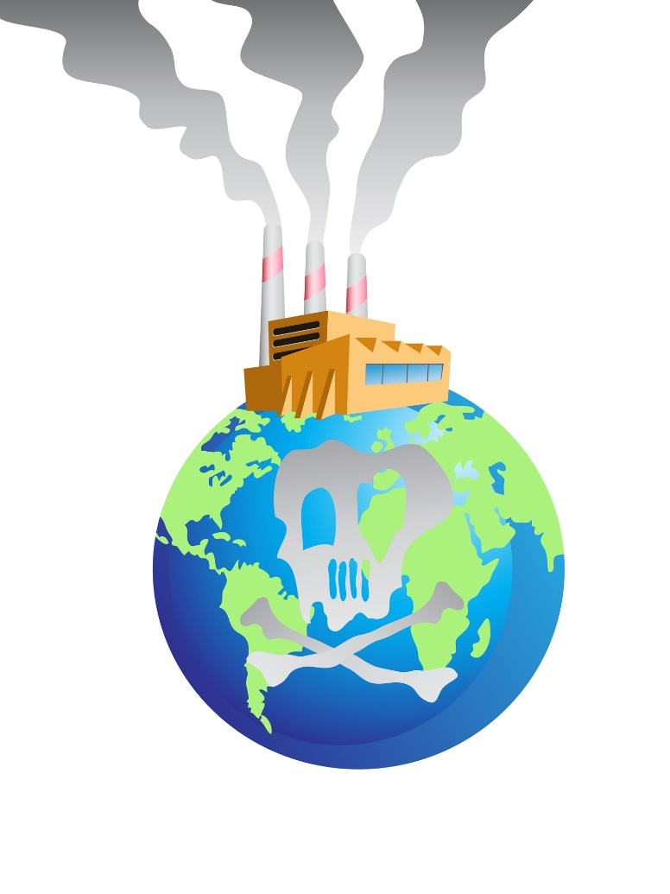
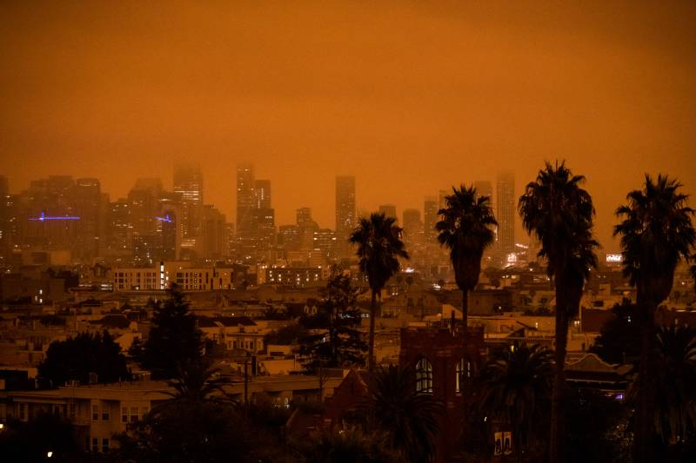

Slide 17

Expanding Importance & Role of EaRTH
Environmental Health
Climate Change
Environmental Justice
FIGO & HEAL infographics
EH + cross-disciplinary collaborations (cancer, diabetes)
CHE Generation Chemical Series
EJ Bootcamp with Columbia
EJ and Human Health: Creating Systemic Solutions Mini-Medical School
U01 & NIEHS CBCRP EJ grant application support
FIGO Climate Paper – Accepted, In Press
Provided funding under Innovation Awards (Mentored Clinician and Mentored Ob/Gyn)
  Climate & Mental Health Infographic
  Association between extreme weather events and low birth weight in Nepal
Notes:
TRACEY

Slide 19



Petro-chemical connection
Phthalates

Slide 20






Toxic Substances Control Act (TSCA) – law that governs ~40,000 industrial, commercial, consumer product chemicals

Slide 21
How many chemicals are we exposed to?
Critical period of development with unique susceptibility to biological/chemical perturbations
~80,000 chemical substances in total
The inventory does not include
Pesticides
Food additives
Drugs
Cosmetics
Tobacco products
Nuclear materials
Munitions
~40,000 chemical substances actively used in the US
Chemical manufacturers in the united states are allowed to self-regulate

Slide 22
TSCA amended in 2016
Federal actions override states
Key decisions left to implementation
Require addressing risk to susceptible subpopulations who ‘…may be at greater risk than the general population of adverse health effects from exposure to a chemical substance or mixture, such as infants, children, pregnant women, workers, or the elderly.’
High Priority Chemicals Undergoing Review
p-Dichlorobenzene | Di-isobutyl phthalate (DIBP)
1,2-Dichloroethane | Dicyclohexyl phthalate
trans-1,2- Dichloroethylene | Dibutyl phthalate (DBP)
o-Dichlorobenzene | Butyl benzyl phthalate (BBP)
1,1,2-Trichloroethane | Di-ethylhexyl phthalate (DEHP)
1,2-Dichloropropane | Ethylene dibromide
1,1-Dichloroethane | 1,3-Butadiene
4,4'-(1-Methylethylidene)bis[2, 6-dibromophenol] (TBBPA) | HHCB
Tris(2-chloroethyl) phosphate (TCEP) | Formaldehyde
Phosphoric acid, triphenyl ester (TPP) | Phthalic anhydride
Chlorinated solvents
Flame retardants
Phthalates

Slide 23
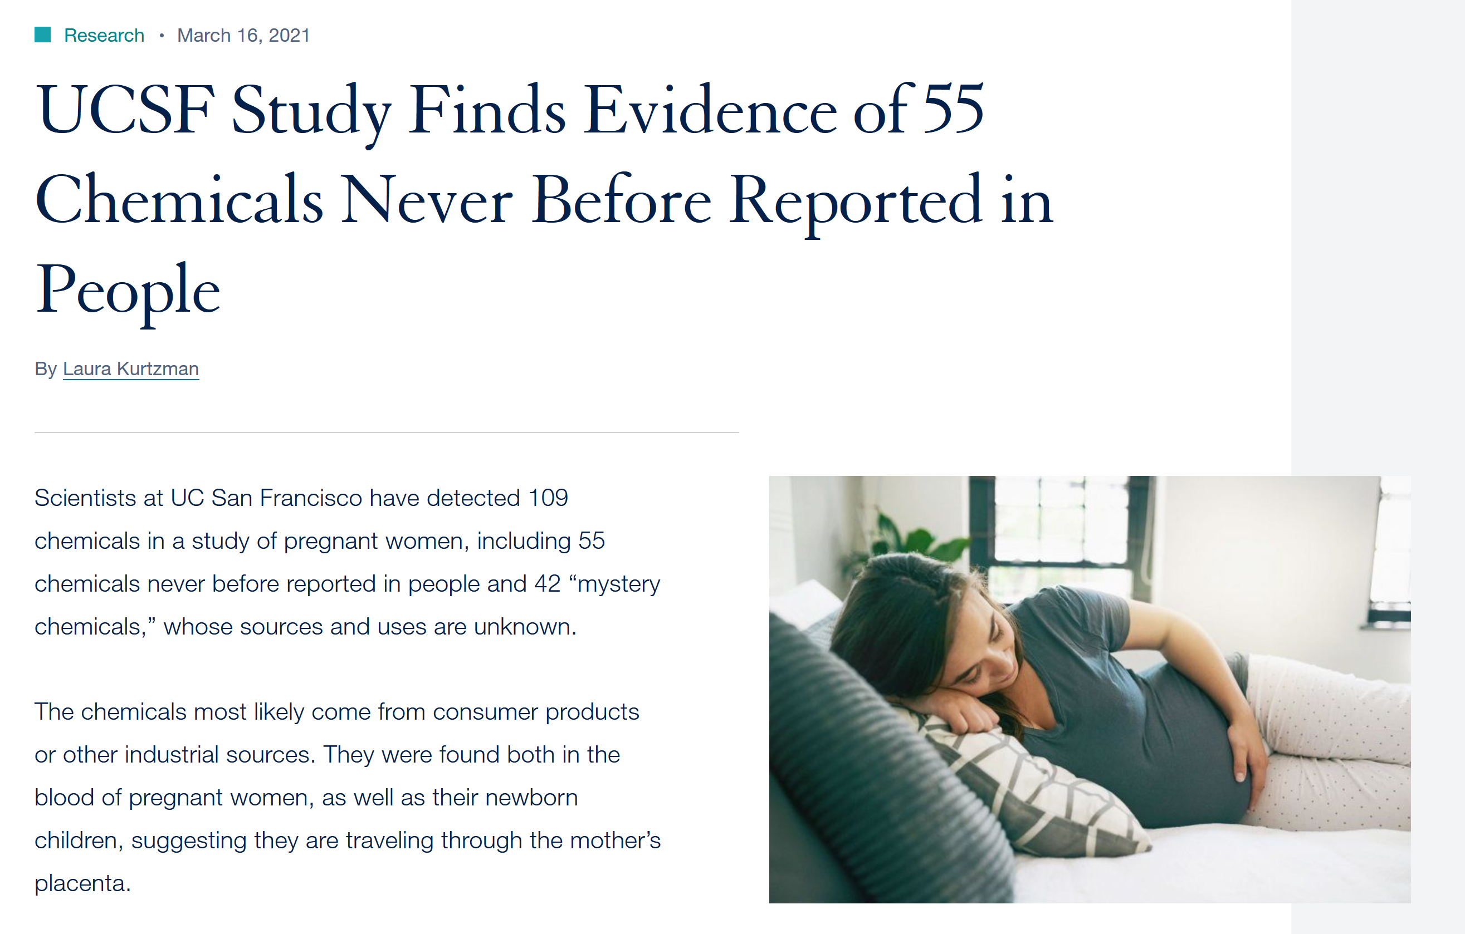
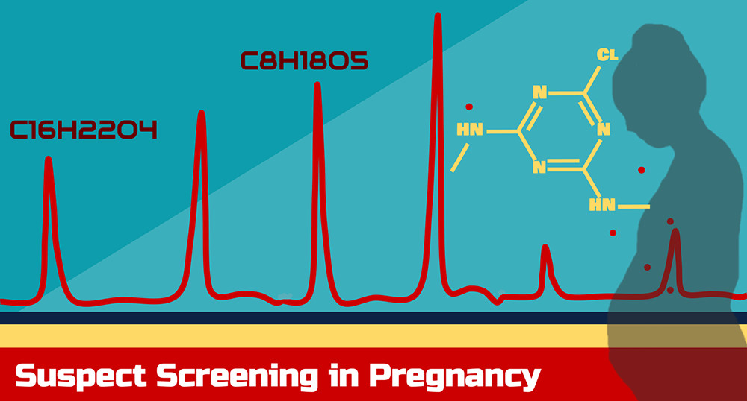

Slide 24


The Science Response Network Amplifies Expert Voices in Science Policy Decision-Making
Scientists who care about science in policy making
Comprised of over 200 scientists, academics, and clinicians representing 9 countries, 22 states, and 58 universities.
Notes:
Talking points:
- to help advance our goals, we created the SRN...

Slide 25
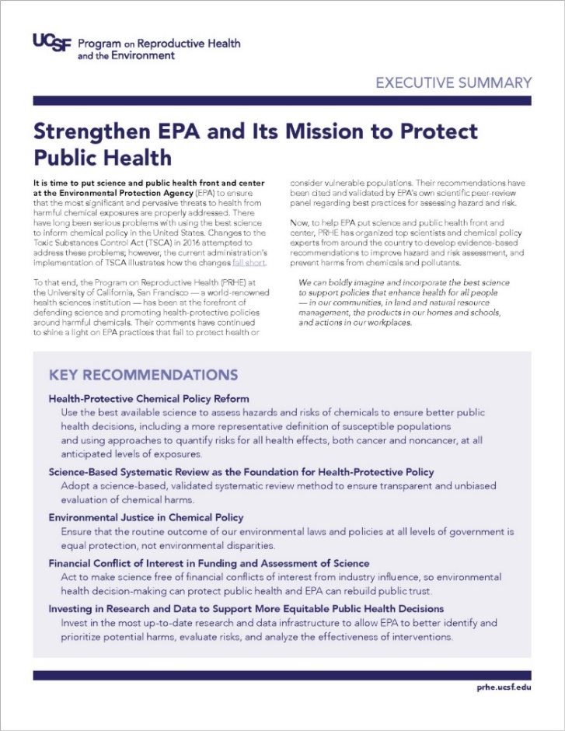

Our Recommendations to EPA
Key Recommendations (Signed by 70+ experts and organizations):
Health-Protective Chemical Policy Reform
Science-Based Systematic Review as the Foundation for Health-Protective Policy
Financial Conflict of Interest in Funding and Assessment of Science
Environmental Justice in Chemical Policy
Investing in Research and Data to Support More Equitable Public Health Decisions
https://prhe.ucsf.edu/recommendations-epa
Notes:
As a part of our follow up from our overall short-term priorities (below) we generated these key recommendations to EPA:
Unless proven otherwise, EPA should assume that risks of all health effects to industrial/environmental chemicals can occur at any anticipated level of exposure, as recommended by authoritative scientific bodies and the agency should quantify risks accordingly.
EPA should expand its definition of potentially susceptible populations, like the 2017 proposed TSCA framework rule.
To address human variability, EPA should implement adjustment factors in use or recommended by authoritative bodies.
U.S. regulatory agencies should have a unified approach around characterizing exposures to environmental pollutants for rulemaking.
To accelerate risk management and avoid regrettable substitutions, EPA must consider chemicals as a class or category. Specifically, EPA should consider, at a minimum, the 5 phthalates banned by CPSC under review as a group under TSCA Sec 26(c).

Slide 26

Conclusions:
Environmental chemical exposures ubiquitous and adversely affecting health inequitably
More needs to be known and done to address exposures
Public policy is necessary to create lasting and fair solutions for all

Slide 27

THANK YOU!
For more information
earth.ucsf.edu
Follow us
@UCSFEaRTH

